Slide 1
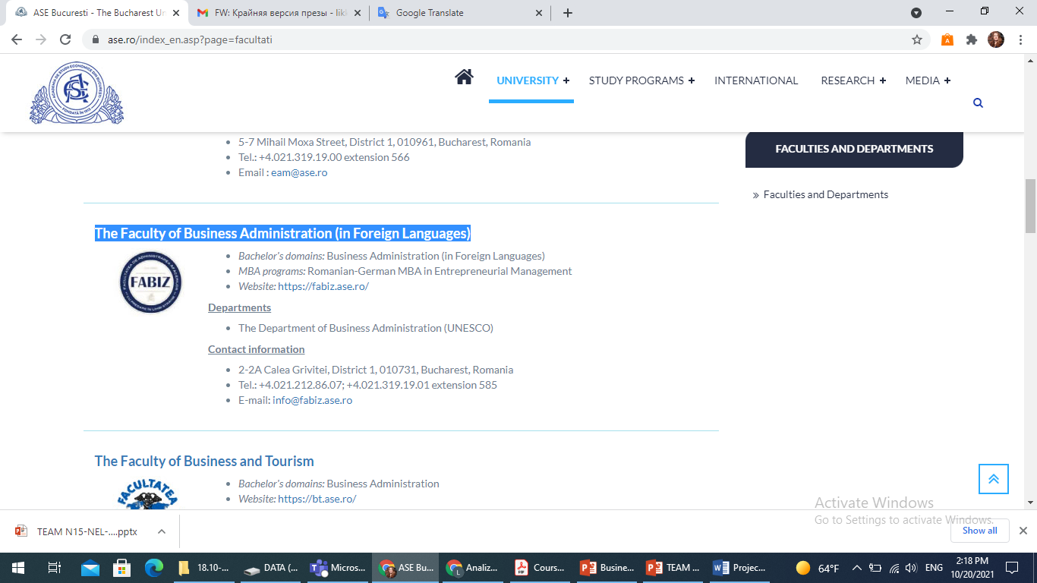
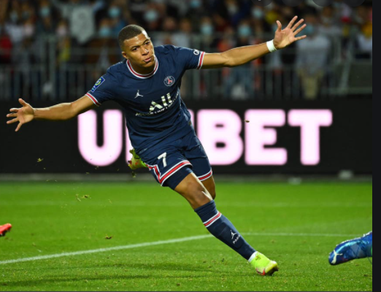
Kylian Mbappé Performance VS Market value
Bucharest University of Economic Studies The Faculty of Business Administration (in Foreign Languages)
Descriptive and predictive analysis of how the performance of Football player effects on his Market Value
IMBA students:
Abdallah Hatamleh
Dragos Bucur
Lia Koldelashvili

Slide 2
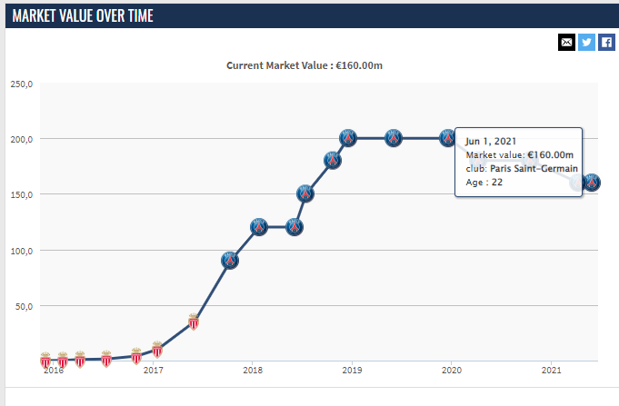
Introduction
For the last decade Football changed the meaning and it is considered more as a business field than just a sport. That’s why is important to analyze the data of football player’s performance to asses his Market Value.
The Goal of our research was:
To practice our first steps into Data Analysis with Python
To analyze the career of Kylian Mbappe for his last 4 seasons, because for the past 2 years there is a negative trend of his market value.
To predict goals for current season
Figure 1. Market Value over time up to now
Source: https://bit.ly/3dOUuMR (Last seen on 11/12/2021)

Slide 3
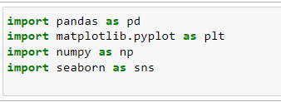
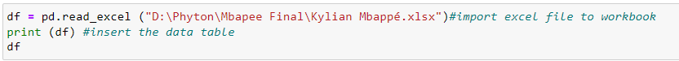
Methods
Coding in Python
We started with the collecting information about Kylian Mbappe’s last 4 seasons, prepared data for libraries and began coding processes.
We imported the following libraries that helped us in the preparing of this project.

Slide 4
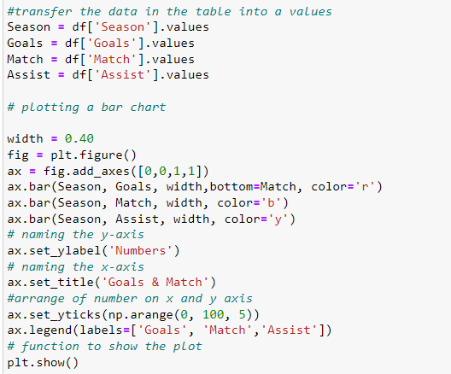
Methods
Coding in Python
Question(1):
Descriptive Analysis for the player’s number of matches, Goals and assist over seasons

Slide 5
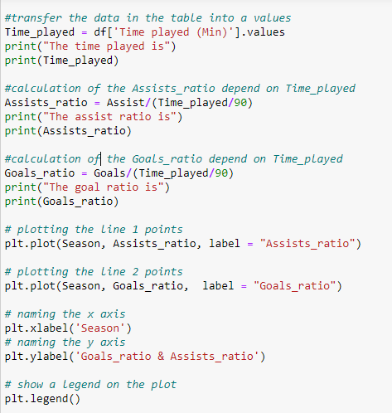
Methods
Coding in Python
Question (2)
Calculation of the player's goals and assists ratio depending on the time played through the season

Slide 6
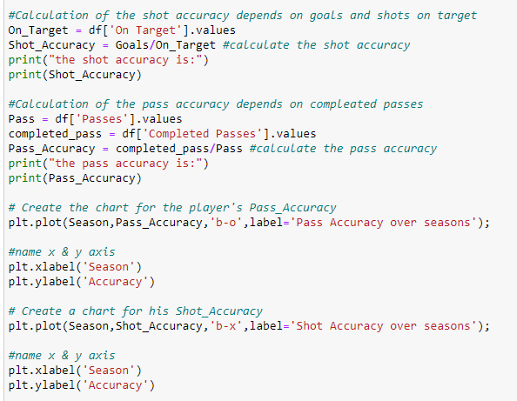
Methods
Coding in Python
Question (3).
Calculation of the shot & pass accuracy (out of 1)

Slide 7
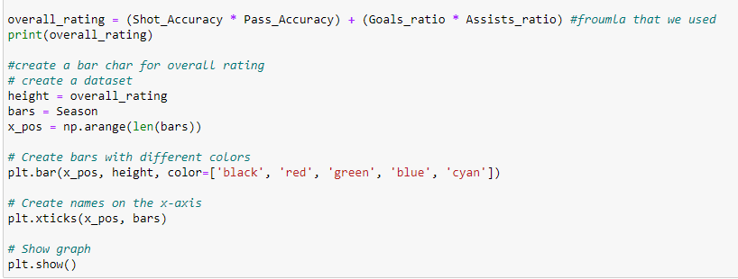
Methods
Coding in Python
Question (4) Calculation of the overall rating depends on goals and assists ratio & shot and pass accuracy (out of 1)

Slide 8
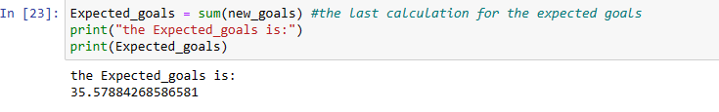
Methods
Coding in Python
Question (5) calculation of the Expected Goals
#In order to get the expected goals for the current season we used the formula, which was created by us depend on the data we used :
Time ratio | Goal’s ratio | Shot Accuracy | Number of goals | shot on target
Firstly, we calculated: X ratio = Time ratio * Goals ratio * Shot Accuracy
Then, calculated: Y ratio = (X ratio * goals over seasons) + (X ratio*shot on target over seasons)
Then, we took percent of his performance for the last season and the previous seasons like that:
40% of his performance for the last season (2020/2021)
60% distributed on other seasons equally (2019/2020, 2018/2019, 2017/2018)
Then, we Calculated the expected goals:
New goals = ∑(Y ratio for each season * Percent of his performance)
Expected_goals = sum of (new goals over seasons)

Slide 9
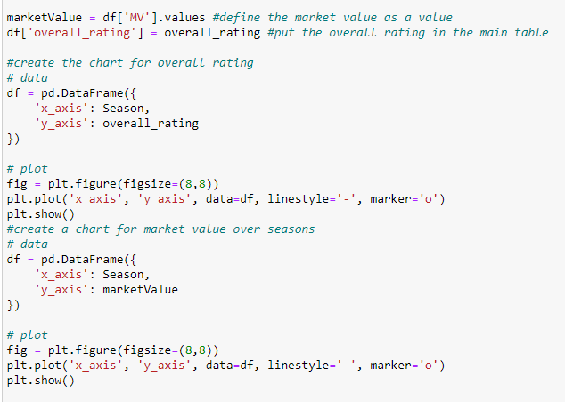
Methods
Coding in Python
Question (6)
Market value and overall rating

Slide 10
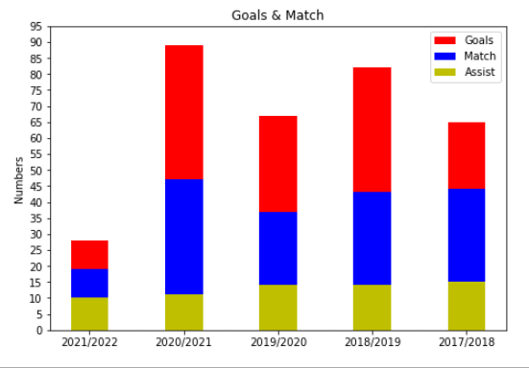
Results
We found: N1
Descriptive Analysis for the players’ number of matches, Goals and assist over seasons is like that:

Slide 11
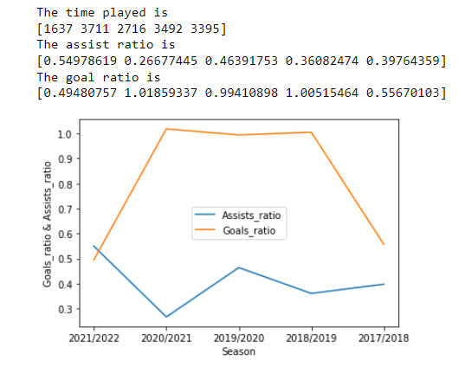
Results
We found: N2
.

Slide 12
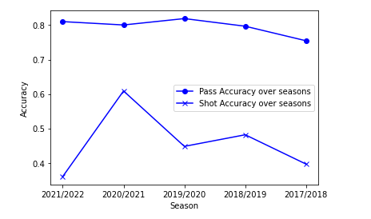
Results
We found: N3 The player’s accuracy out of 1 is:
 | 2021/2022 | 2020/2021 | 2019/2020 | 2018/2019 | 2017/2018
Shot accuracy | 0.36 | 0.60 | 0.44 | 0.48 | 0.39
Pass accuracy | 0.81 | 0.80 | 0.81 | 0.79 | 0.75
.

Slide 13
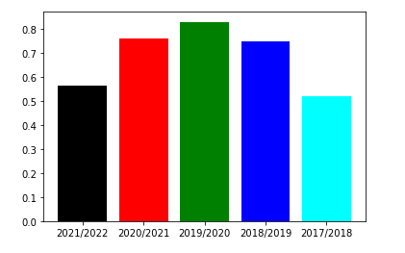
Results
We found: 4. The overall rating (out of one)
Which is equal of (Shot Accuracy * Pass Accuracy) + (Goals ratio * Assists ratio)
.
 | 2021/2022 | 2020/2021 | 2019/2020 | 2018/2019 | 2017/2018
Overall rating | 0.56 | 0.75 | 0.82 | 0.74 | 0.52

Slide 14
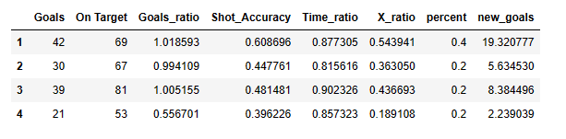

Results
We found: N5 The Expected Goals
.
The Expected Goals is: 36

Slide 15
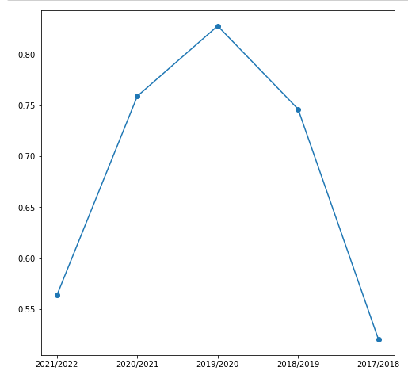
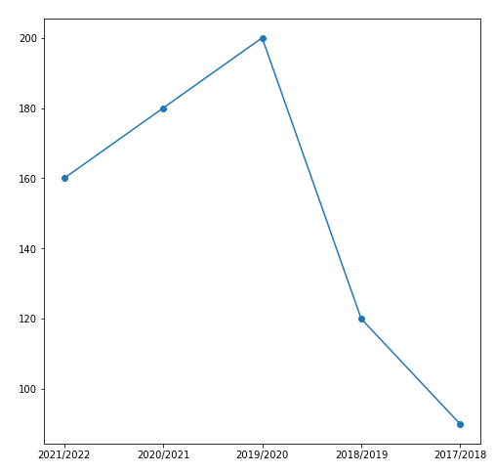
Results
We found: 6 Market value and overall rating
Overall rating defined out of 1
Market Value defined in Million USD

Slide 16
Discussion
It means:
That for strategic planning of players’ performance, which is one of the main variable for defining of the market value, it is important to analyze data for the past seasons for both parties – for the player and for the Club.
.
Negative trend of market value is due to less matches during the seasons of 2019/2020, 2020/2021. Reason of this is CoVid19
According to the predicted goals we can predict Market value of the player.

Slide 17
.
Thank You for Your Attention!

